Slide 1
To-Do List Android Project
By Ben Faulkner

Slide 2
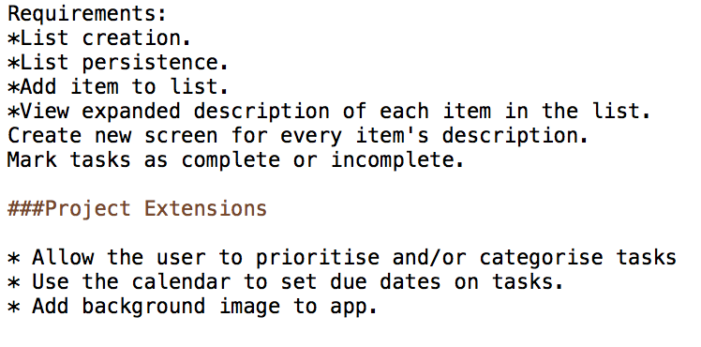
Planning

Slide 3
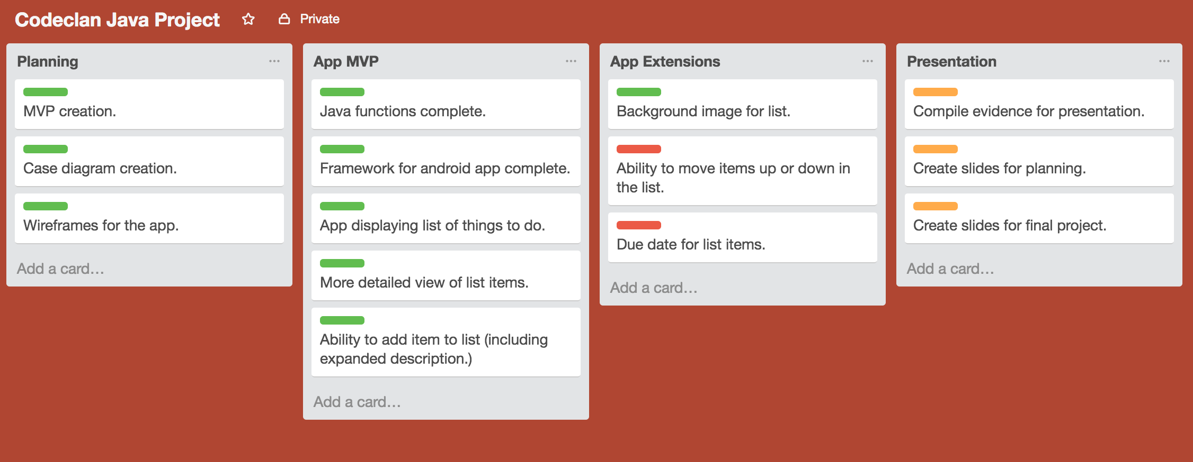
Planning

Slide 4
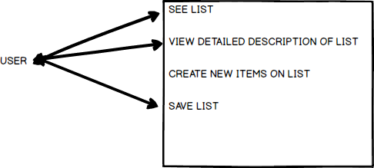
Case Diagrams

Slide 5
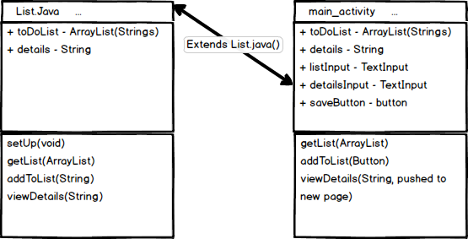
Case Diagrams

Slide 6
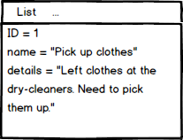
Case Diagrams

Slide 7
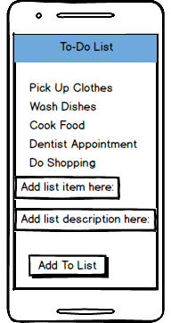
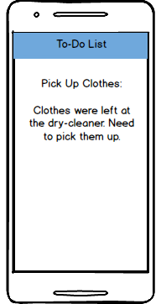
Mockups

Slide 8
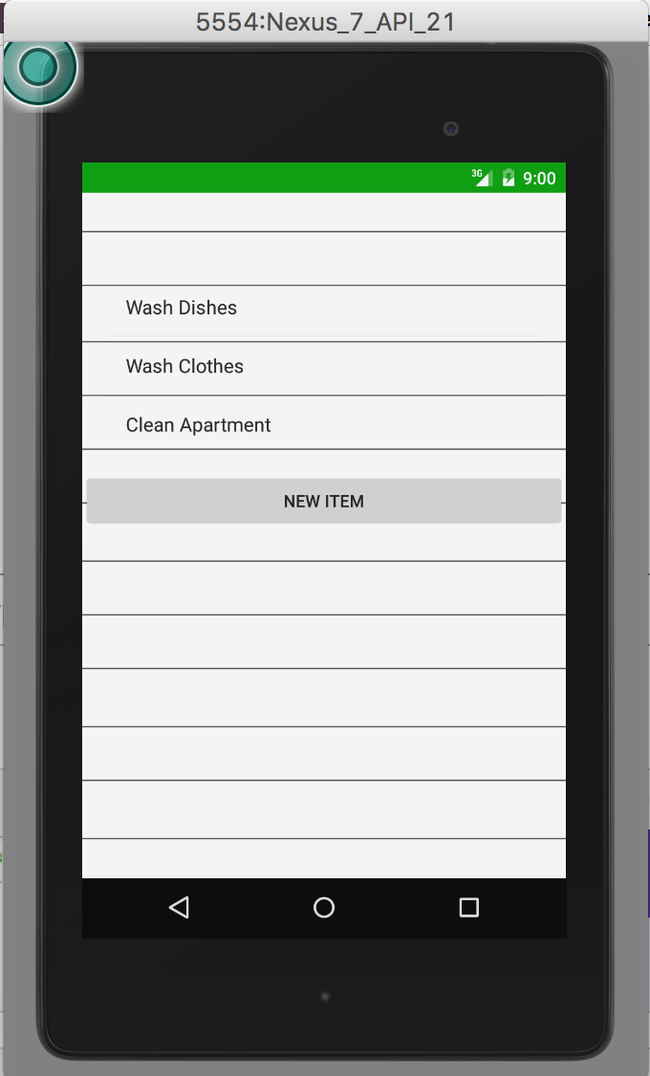
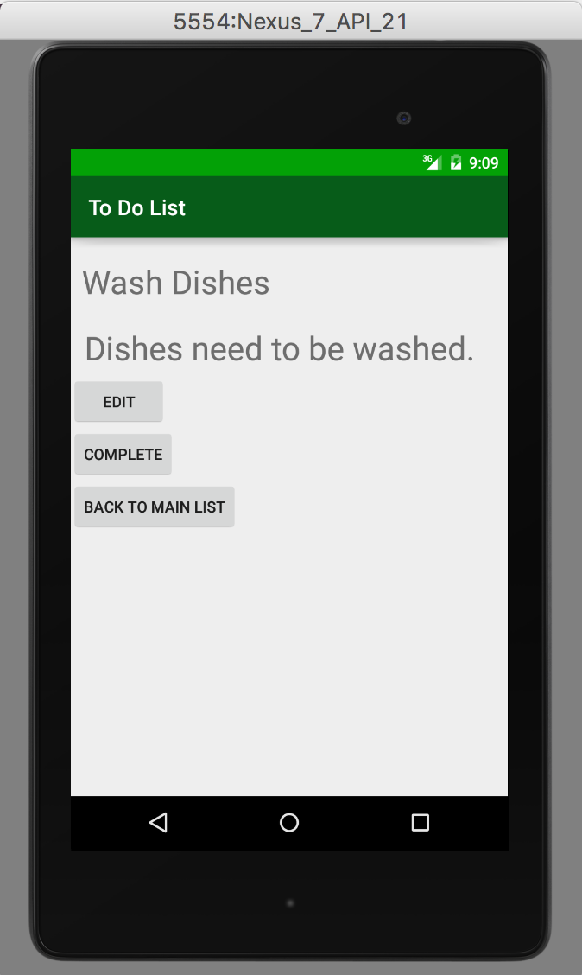
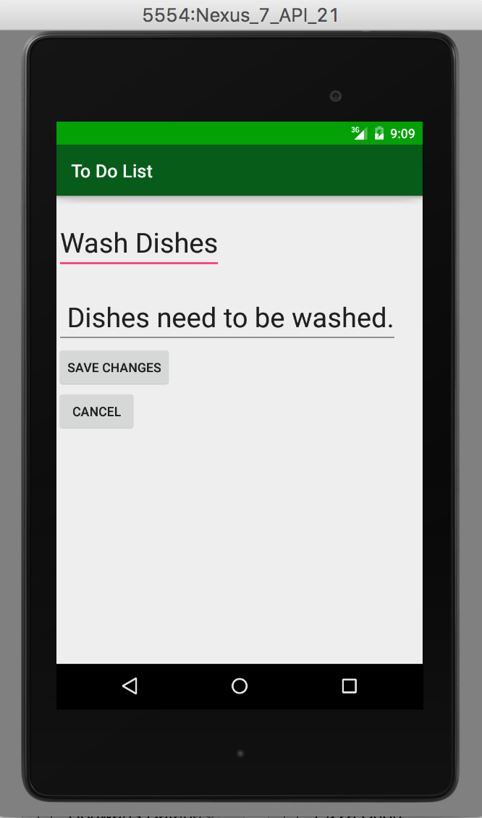
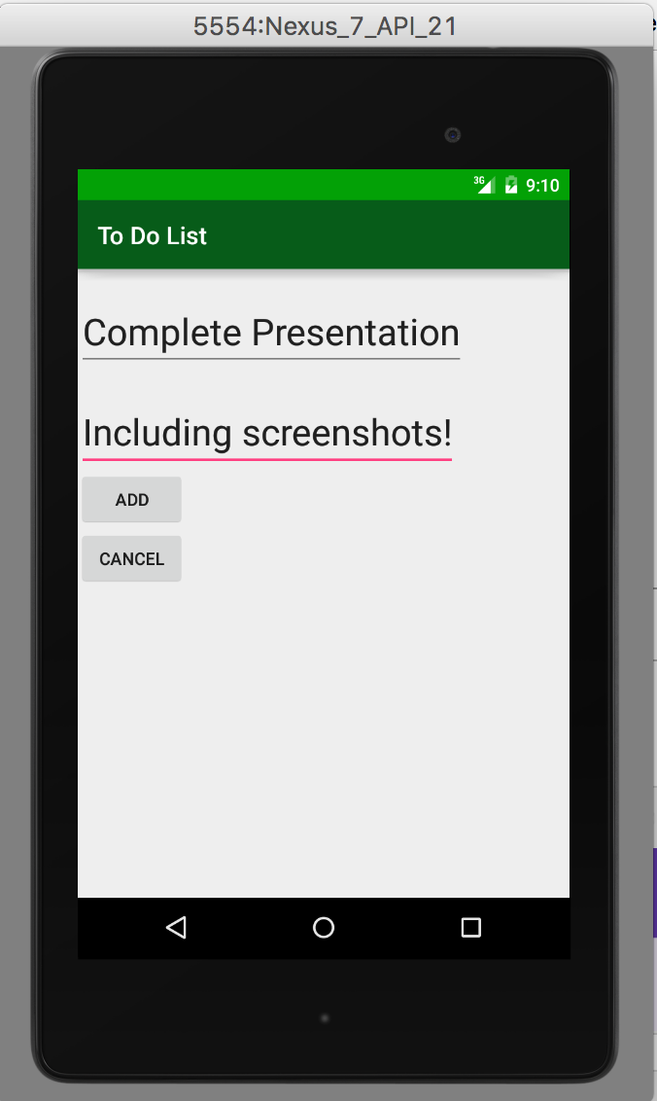
Execution

Slide 9
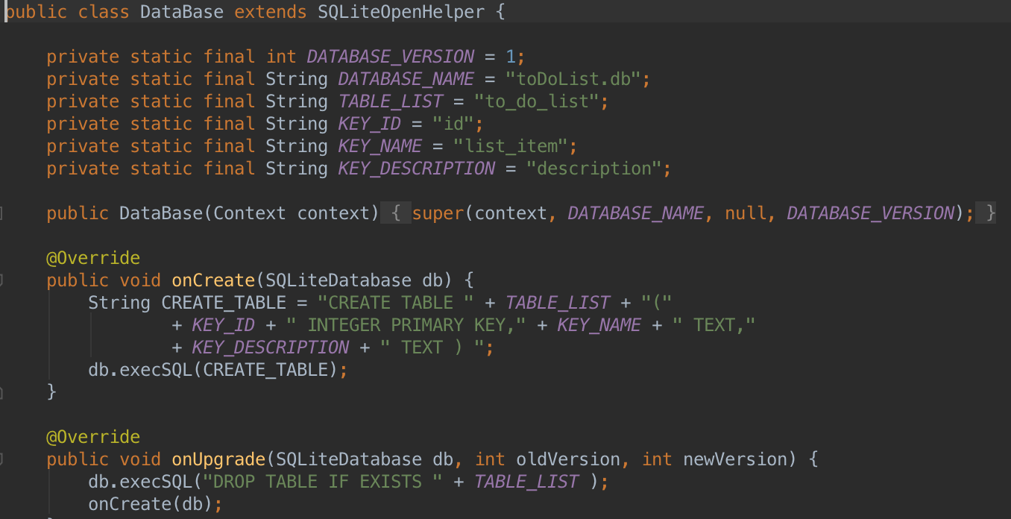
SQL Persistence

Slide 10
Conclusion
Much happier with how this project came out.
More time, less sickness, better on the whole.
Learned how to deal with some more esoteric errors while dealing with Android Studio.
Questions?

